Slide 1
Deep drowsiness detection USING ML/DL
FROM - VIGNAN INSTITUTE OF INFORMATION TECHNOLOGY
TEAM:
N.S.Hema
S.Harika
K.Venkatalakshmi
S.Keerthi
S.Yasaswini Sai

Slide 2
INTRODUCTION to the problem statement:
Our Project mainly focus on the Cars – that is at Integrated Head Unit.
INTEGRATED HEAD UNIT – In vehicles Integrated Head Unit is a touch screen based , tablet-like device, mounted on the vehicles dashboard.
Our model can be able to detect the face of the person who are about to sleep and have drowsy facial expressions.
Most of the costly vehicles have already implemented this idea partially and some companies are trying to adopt this idea.
But those vehicles are not suitable for the Indian Roads and is not encouraged by our Government.
What if this safety is also implemented in all the vehicles that are available in the Indian Motor Vehicle Companies ?

Slide 3
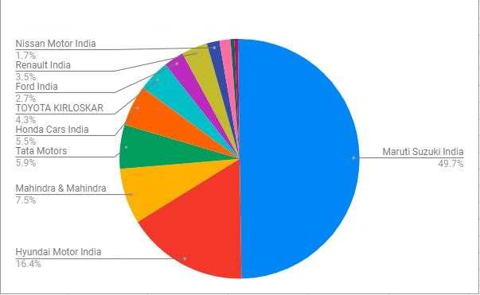
Case study
Let us consider this sales chart of 2018-2020;
Our Project deeply evolves around the vehicles that are being sold in our Country.
If all the Indian vehicles can adopt this model, We can save 70% of the people from accidents.
Nearly 49.7% of the people are buying Maruti Suzuki.

Slide 4
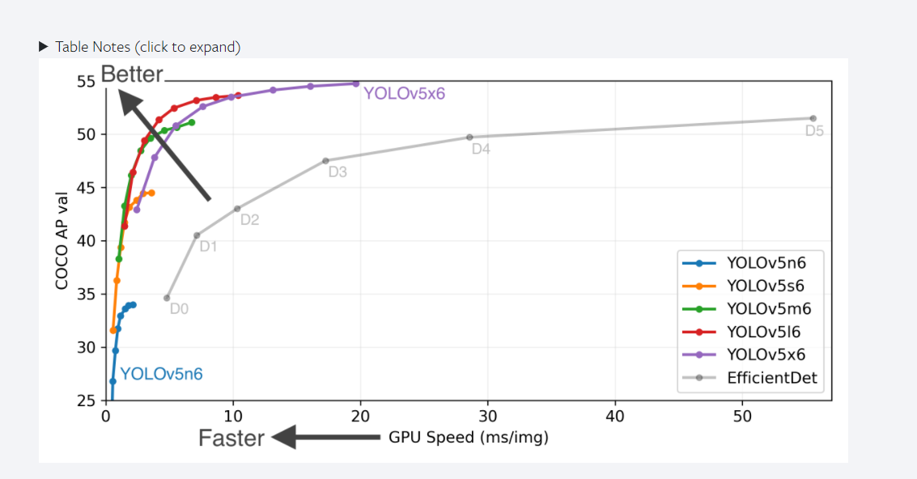
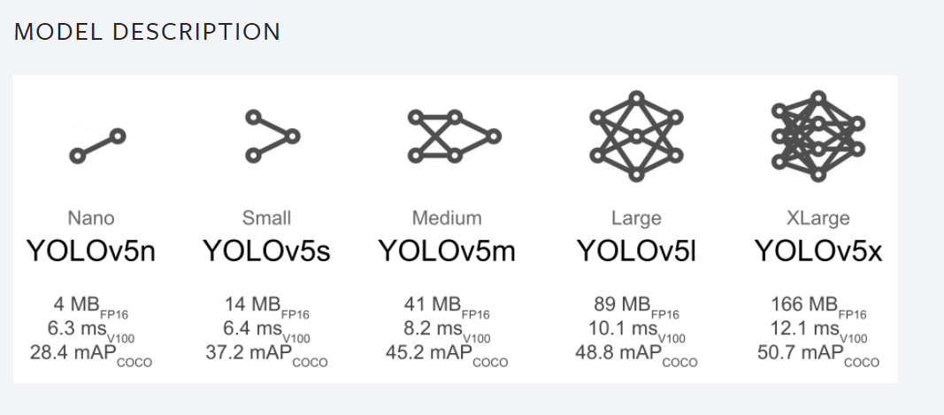
Solution for the problem statement:
1. Installing Dependencies-
2. Loading the Model From Torch Hub-
PyTorch
YOLOv5
Base – Matplotlib, NumPy, OpenCV, Torch, Torch vision
Plotting – Pandas, Seaborn
We will load “Ultralytics YOLOv5” from Torch Hub.
It enables us to get a lot of layers of an Image that are loaded here.

Slide 5
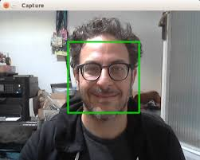
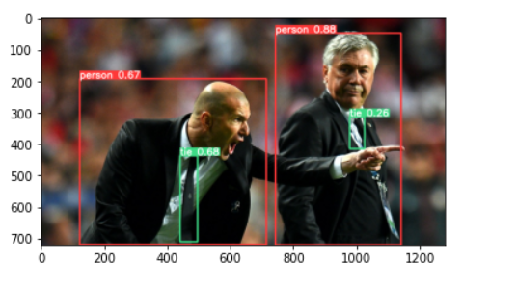
3. Making Detections with Images
4. Real Time Detections -
We import some inbuilt images from COCO Classes and try to identify the objects that are present in that image.
Our Model will be able to detect the persons and objects and are enclosed in the rectangle boxes.
Using OpenCV , we will detect the real person faces from web cam.
OpenCV can be used if we want to detect in the real time applications.

Slide 6
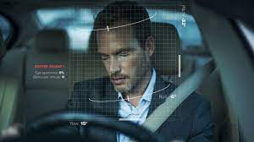
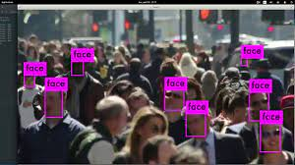
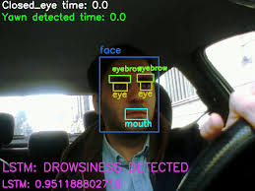
5. Training the Model -
6. Detecting Drowsiness -
Finally this Model will be able to detect the Drowsy Face and alert the person to awake.
This is can implemented with YOLO algorithm.
We use PyTorch and Yolov5 algorithm to train the model.
Yolov5 employs CNN Convolutional Neural Network to detect the objects in the real time.
Yolo Algorithm working-
A. Residual Blocks
B. Bounding Box Regression
C. Intersection Over Union (IOU)

Slide 7
THANK YOU !

